Slide 1

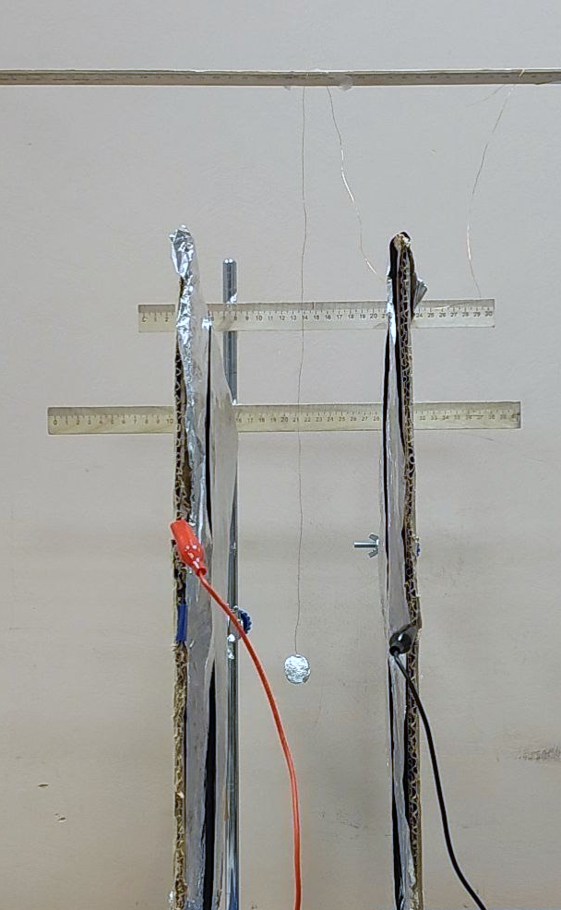
Charge Meter
The Reporter | Tim Semenikhin
The force of electrical interaction between stationary charges is incredibly strong. But it is nevertheless quite difficult to measure the electric charge of conducting bodies with high accuracy. A charge that is too small does not interact with any noticeable force. Too much charge creates high electrostatic pressure and flows into the air. The aim of our study was to create an electrometer able to measure electric charge with high accuracy.

Slide 2
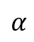

Summary
1)
2)
3)
Calculating charge from potentials of sphere, plates and distances between them
Doing an experiment
Calculating charge from NSL
$$α$$
T_{tension}
F_{electricity}
$$α$$
M
y
F_{gravity}
O

Slide 3
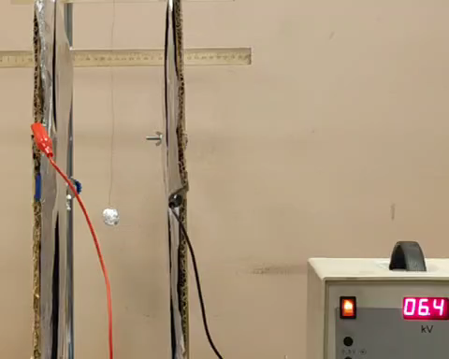
Setup

Slide 4
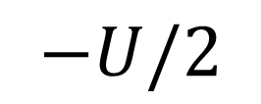


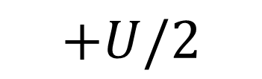
Experimental data
$$+U/2$$
$$−U/2$$
$$x$$
$$+U/2$$

Slide 5
Summary
1)
2)
3)
Calculating charge from potentials of sphere, plates and distances between them
Doing an experiment
Calculating charge from NSL
$$α$$
T_{tension}
F_{electricity}
$$α$$
y
F_{gravity}
O

Slide 6
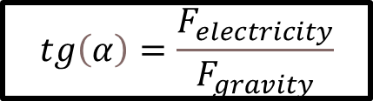
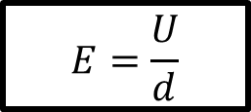
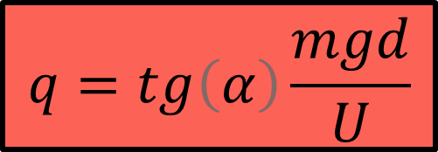
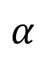
Simple model. Forces acting on a sphere
$$tg\left(α\right)=\frac{F_{electricity}}{F_{gravity}}$$
$$E=\frac{U}{d}$$
$$α$$
$$q=tg\left(α\right)\frac{mgd}{U}$$
F_{electricity}
T_{tension}
F_{gravity}
C

Slide 7
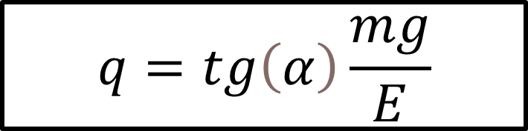
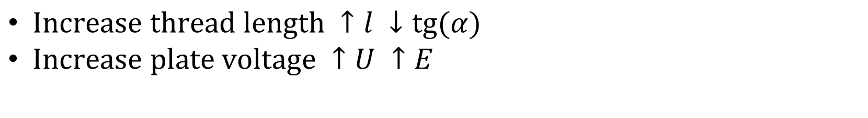

Optimization of installation for measuring the smallest charges
$$q=tg\left(α\right)\frac{mg}{E}$$
$Increase thread length ↑l ↓tg⁡(α)$
$Increase plate voltage ↑U ↑E$
The minimum deviation that we can record – 1$∙$10⁻³ m
The maximum voltage we can report – 3$∙$10⁴ V
$$Qmin=tgmin\frac{mg}{Emax}={10}^{−9}C$$

Slide 8
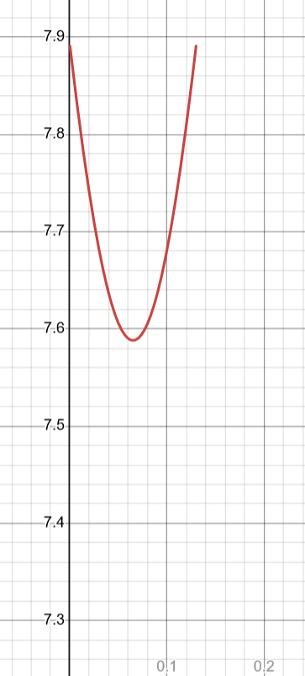
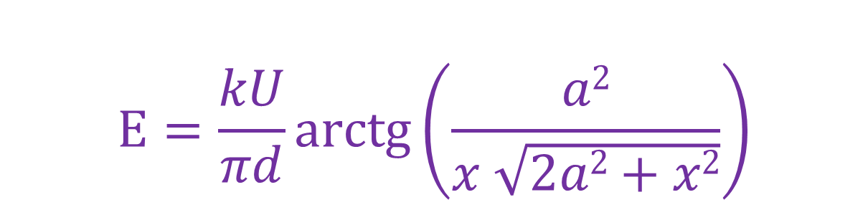
Refined model. Field of one plate on the axis passing through the center of the plate
$$E=\frac{kU}{πd}arctg⁡\left(\frac{a2}{x \sqrt{2a2+x2}}\right)$$
E
E(x)
Uniform field
Between the plates, the field calculated by the formula for a uniform charge on the plates changes by 5%
X
i, j – все пары соседних чисел

Slide 9

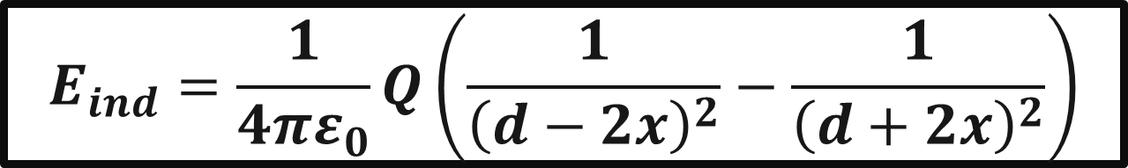

Ball-induced charges on plates
$$E_{ind}=\frac{1}{4πε_{0}}Q\left(\frac{1}{{\left(d−2x\right)}^{2}}−\frac{1}{{\left(d+2x\right)}^{2}}\right)$$
-Q
h
+Q
-Q
x
d
$$E_{ind}\sim Q$$
$$F_{ind}\sim Q2$$

Slide 10
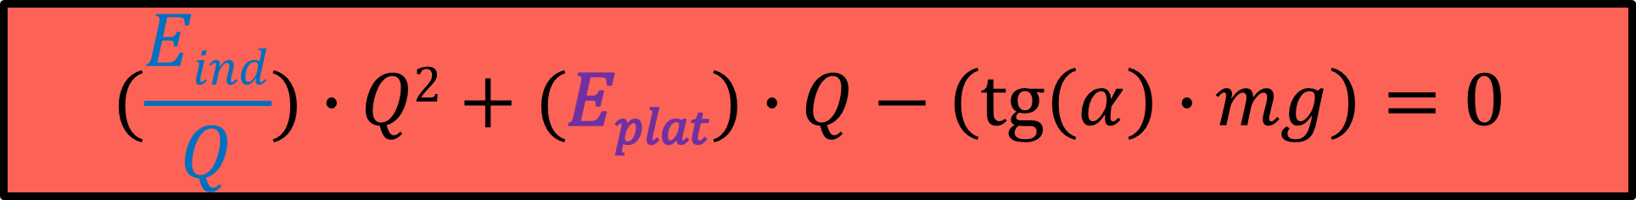
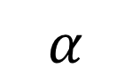
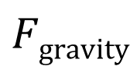
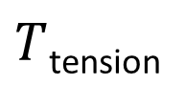
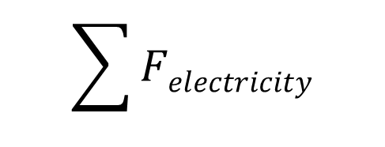
Calculation of the charge based on all the acting forces
First model
Refined model
$T$_{tension}
$$α$$
$$\sum{Felectricity}$$
C
$$Fgravity$$
$$(\frac{Eind}{Q})∙Q2+(Eplat)∙Q−\left(\operatorname{tg}\left(α\right)∙mg\right)=0$$

Slide 11
Summary
1)
2)
3)
Calculating charge from potentials of sphere, plates and distances between them
Doing an experiment
Calculating charge from NSL
$$α$$
T_{tension}
F_{electricity}
$$α$$
M
y
F_{gravity}
O

Slide 12
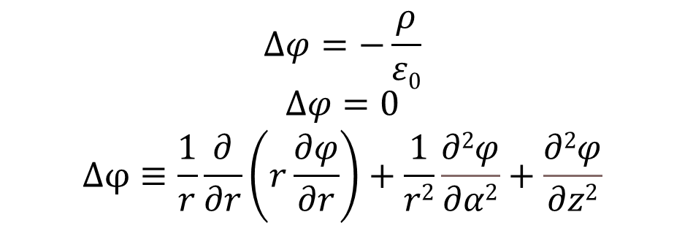


Modeling a complex capacitor system for charge calculation
a
d₁
$$r$$
M
$$∆φ=−\frac{ρ}{ε0}$$
$$∆φ=0$$
$$Δφ≡\frac{1}{r}\frac{∂}{∂r}\left(r\frac{∂φ}{∂r}\right)+\frac{1}{r2}\frac{∂2φ}{∂α2}+\frac{∂2φ}{∂z2}$$
$$α$$
r
d₂
O
12

Slide 13
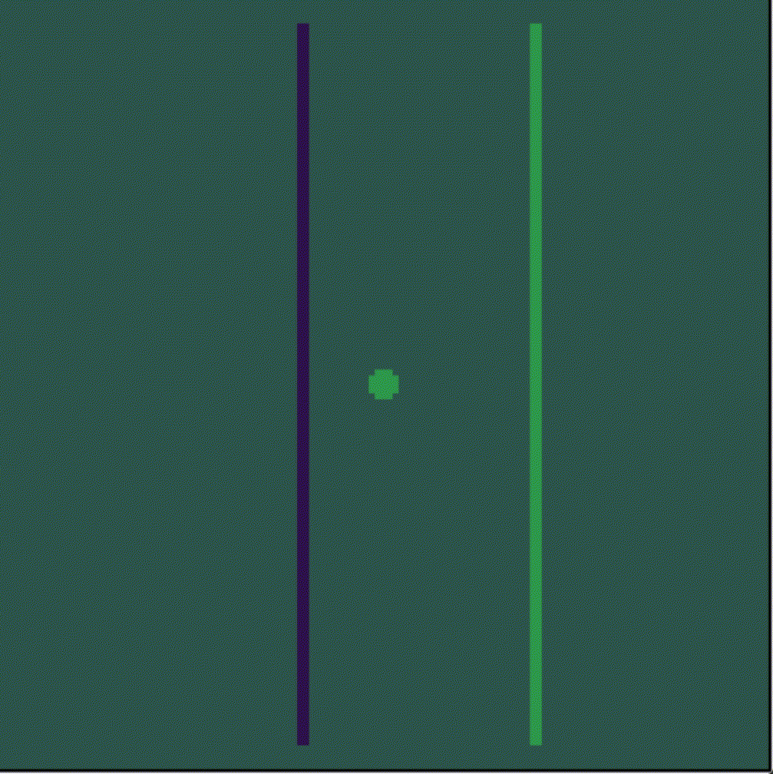
Distribution of potential in space with the course of iterations

Slide 14
Results
Modeling
First model
Refined model
In the range of 3-5 kV, the simulation converges with mathematical methods ∆<8%.In this range, the simplified mathematical model differs little from the complicated one ∆<1%
C

Slide 15
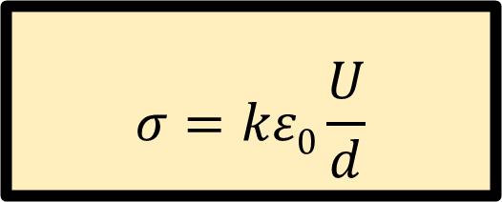
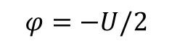
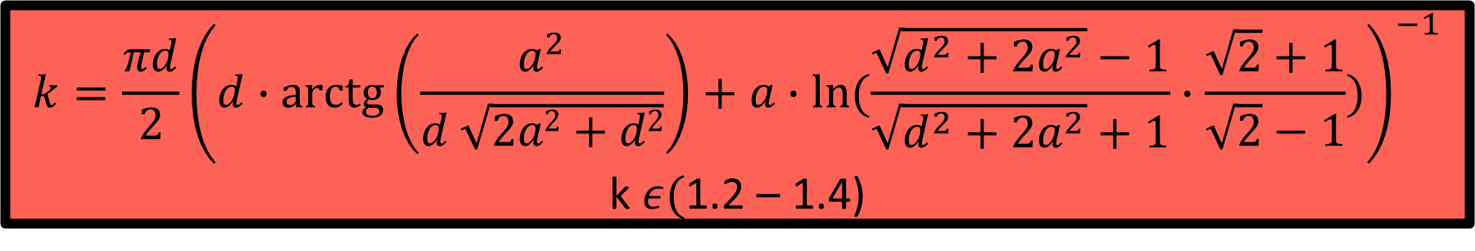
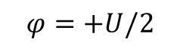
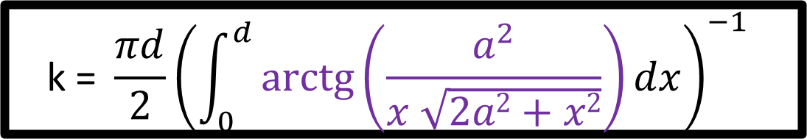
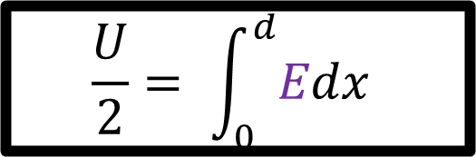
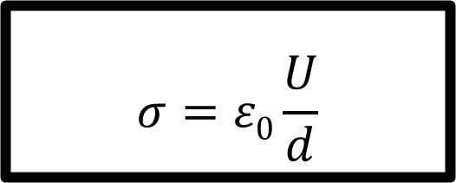
Calculate the surface charge density on the capacitor plates
$$σ=kε0\frac{U}{d}$$
$$σ=ε0\frac{U}{d}$$
$$φ=−U/2$$
$$φ=+U/2$$
$$\frac{U}{2}= \int_{0}^{d}{Edx}$$
$$\text{k}\text{ = }\frac{πd}{2}{\left(\int_{0}^{d}{arctg\left(\frac{a^{2}}{x \sqrt{2a2+x2}}\right)dx}\right)}^{−1}$$
$$k=\frac{πd}{2}{\left(d∙\operatorname{arctg}\left(\frac{a^{2}}{d \sqrt{2a2+d2}}\right)+a∙ln(\frac{\sqrt{d^{2}+2a^{2}}−1}{\sqrt{d^{2}+2a^{2}}+1}∙\frac{\sqrt{2}+1}{\sqrt{2}−1})\right)}^{−1}$$
k $ε($1.2 – 1.4)

Slide 16
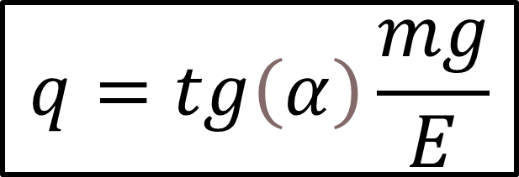
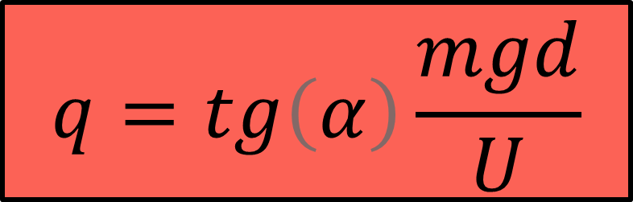
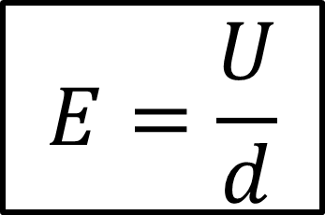
Calculating charge with “uniform field” model
$$q=tg\left(α\right)\frac{mg}{E}$$
$$E=\frac{U}{d}$$
C
$$q=tg\left(α\right)\frac{mgd}{U}$$

Slide 17
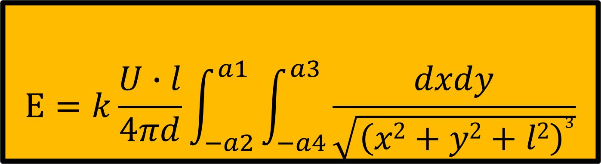
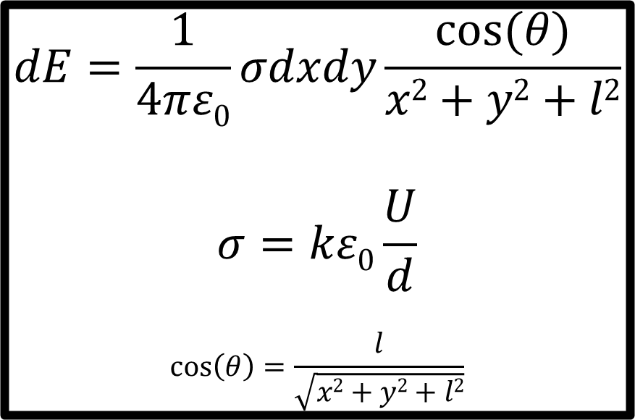
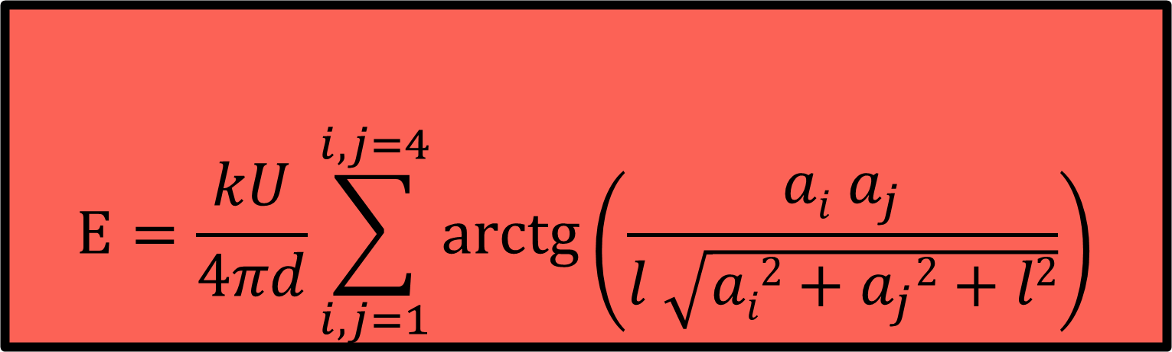
Let us calculate the tension of a plate of finite dimensions
$$E=\frac{kU}{4πd}\sum_{i,j=1}^{i, j=4}{arctg⁡\left(\frac{ai a_{j}}{l \sqrt{ai2+a_{j}2+l2}}\right)}$$
a₁
a₃
Y
$$dE=\frac{1}{4πε0}σdxdy\frac{cos⁡(θ)}{x2+y2+l2}$$
$$σ=kε0\frac{U}{d}$$
$$\cos\left(θ\right)=\frac{l}{\sqrt{x2+y2+l2}}$$
a₄
(0;0)
l
$$E=k\frac{U∙l}{4πd}\int_{−a2}^{a1}{\int_{−a4}^{a3}{\frac{dxdy}{\sqrt{{\left(x2+y2+l2\right)}^{3}}}}}$$
a₂
X

Slide 18
Summary
1)
2)
3)
Calculating charge from potentials of sphere, plates and distances between them
Doing an experiment
Calculating charge from NSL
$$α$$
T_{tension}
F_{electricity}
$$α$$
M
y
F_{gravity}
O

Slide 19
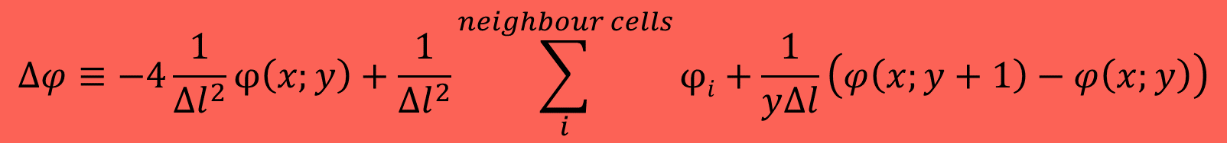
Numerical solving
Let's divide the space into cells, in each of which the potential is constant
X
The potential values ​​in neighboring cells are related through the Laplace equation
The resulting system of equations is solved iteratively
* In the simulation, the grid was 50 times finer
$$∆φ≡−4\frac{1}{{∆l}^{2}}φ\left(x;y\right)+\frac{1}{{∆l}^{2}}\sum_{i}^{neighbour cells}{φi}+\frac{1}{y∆l}\left(φ\left(x;y+1\right)−φ\left(x;y\right)\right)$$
Y

Slide 20
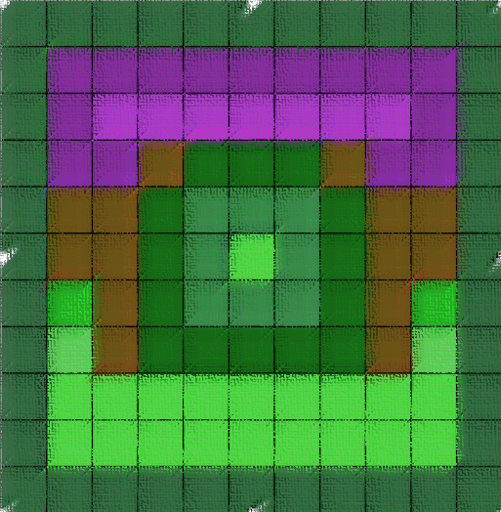
Calculating charge
X
Using the potential distribution we can calculate the charge that creates this potential
*Potential distribution in simple view
Y
$$Q=\int{ρdV}=−2πε0\left(\sum_{x=−r}^{r}{\sum_{y=0}^{r}{∆x∙(φ\left(y+∆y;x\right)−φ\left(y;x\right))−4y∙φ(y;x)+y\sum_{i}^{neighbour cells}{φi}}}\right)$$
20

Slide 21
Experimental parameters
L = 0.35 m
a = 0.42 m
d = 0.12 m
$U= 0 −15 ∙103$ V

Slide 22
Результаты эксперимента
Оценка
Вычисление напряженности
Выводы
Моменты времени, в которые вторая производная равняется нулю соответствуют прохождению сферой положения равновесия

Slide 23
Параметры эксперимента
Радиус сферы – r = 20мм
Отклонение центра сферы от вертикали - x

Slide 24

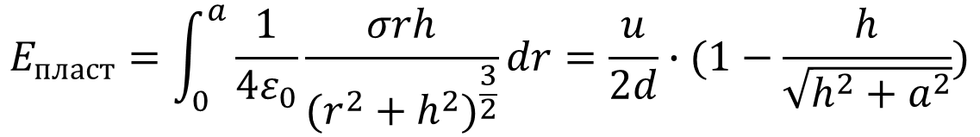
Применим закон Кулона для точной оценки напряженности поля
Поле круглой пластины
$$E_{пласт}=\int_{0}^{a}{\frac{1}{{4ε}_{0}}\frac{σrh}{{(r^{2}+h^{2})}^{\frac{3}{2}}}}dr=\frac{u}{2d}∙(1−\frac{h}{\sqrt{h^{2}+a^{2}}})$$
r
h
Напряженность меняется от $≈$ $u∙6 \text{в центре конденсатора} до ≈u∙7$ в состоянии максимального отклонения, полученного в ходе эксперимента
В пределе $\lim_{a→∞}E=\frac{u}{d}=u∙8,33 В∗м^{−1}$

Slide 25
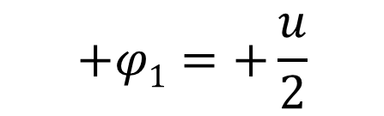
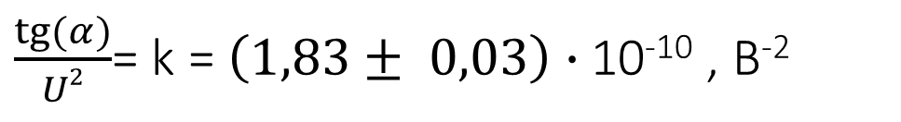
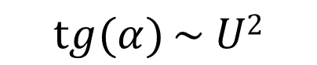

Вычислим значения
Оценка
Вычисление напряженности
Выводы
$$+φ1=+\frac{u}{2}$$
$$C=mg∙d∙2⋅\frac{tg\left(α\right)}{u^{2}}$$
константы
$$\operatorname{tg}{(α)}\sim U2$$
$\frac{tg⁡(α)}{U2}$= k = $\left(1,83± 0,03\right)∙$10⁻¹⁰ , В⁻²

Slide 26
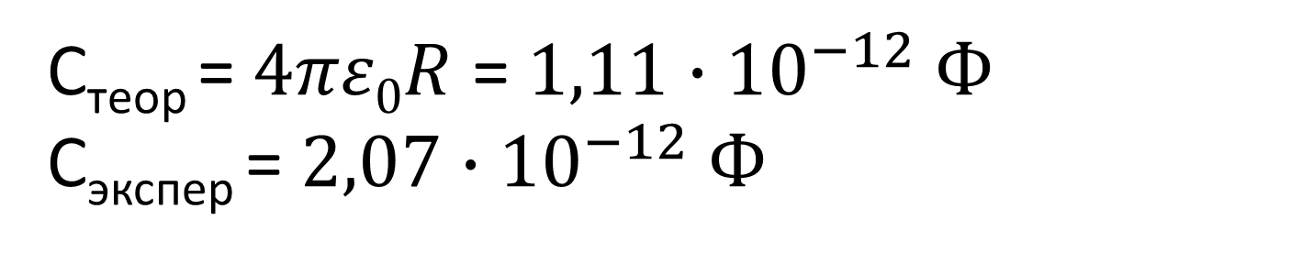
Вычислим значения
Оценка
Вычисление напряженности
Выводы
C_{теор} = $4πε0R$ = $1,11∙{10}^{−12} Ф$
C_{экспер} = $2,07∙{10}^{−12} Ф$
Порядок совпадает, но метод оценочный

Slide 27
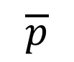
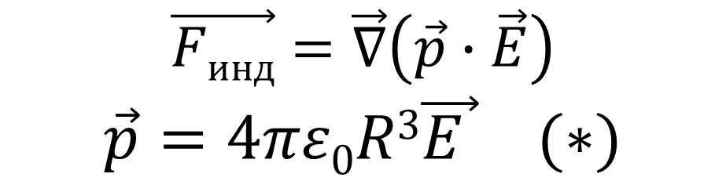
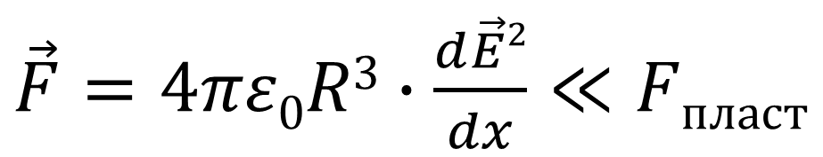
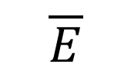
Влияние индуцированных зарядов на шарике от пластин
$$\overline{E}$$
$$\vec{Fинд}=\vec{∇}\left(\vec{p}∙\vec{E}\right)$$
$$\vec{p}=4πε0R3\vec{E } (∗)$$
$$\overline{p}$$
-
+
$\vec{F}=4πε0R3∙\frac{d\vec{E}2}{dx}≪Fпласт$
* Джон Дэвид Джексон (1962) «Классическая электродинамика» стр. 48

Slide 28
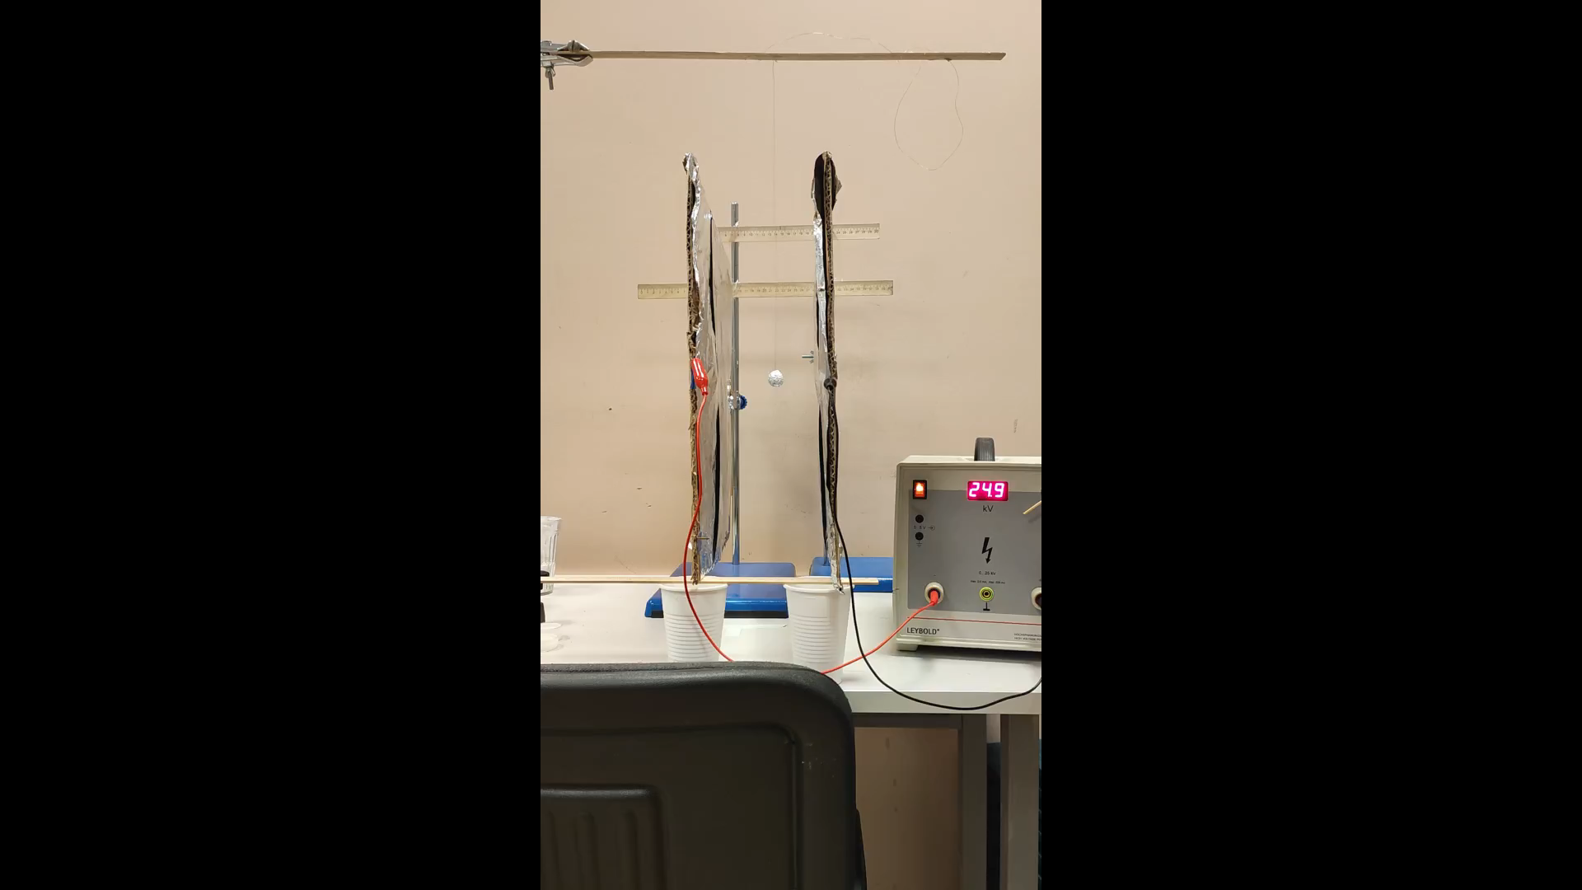
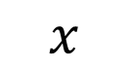
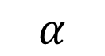
Демонстрация
Установка
$$α$$
$$x$$

Slide 29
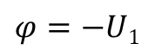
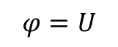




Первый эксперимент
1) Подаем напряжение 2U на пластины
2) Передаем заряд на шарик
3) Отпускаем сферу и наблюдаем величину отклонения
$$φ=U$$
$$φ=−U1$$
$$φ=U1$$
$$φ=−U$$
$$q$$
$$φ=U$$

Slide 30

Вычисление напряженности одной пластины
a₁
a₃
$$E=k\frac{U∙l}{4πd}\int_{−a2}^{a1}{\int_{−a4}^{a3}{\frac{dxdy}{\sqrt{{\left(x2+y2+l2\right)}^{3}}}}}$$
a₄
(0;0)
l
Y
a₂
X

Slide 31


Напряженность поля конечного конденсатора
$$E= \left[k\frac{U∙l}{4πd}\int_{−a2}^{a1}{\int_{−a4}^{a3}{\frac{dxdy}{\sqrt{{\left(x2+y2+l2\right)}^{3}}}}}\right]=$$
$$=\frac{kU}{4πd}\sum_{i,j=1}^{i, j=4}{arctg⁡\left(\frac{ai aj}{l \sqrt{ai2+aj2+l2}}\right)}$$
i, j – все пары соседних чисел

